Slide 1
Introduction to Computer Vision
7. Keypoint detection
25.11.22
Mikhail Belyaev

Slide 2
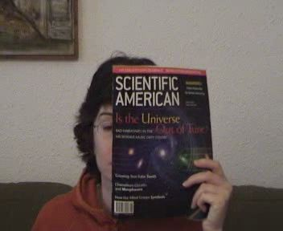
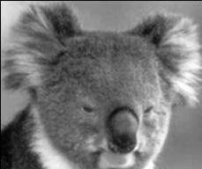
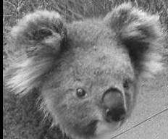
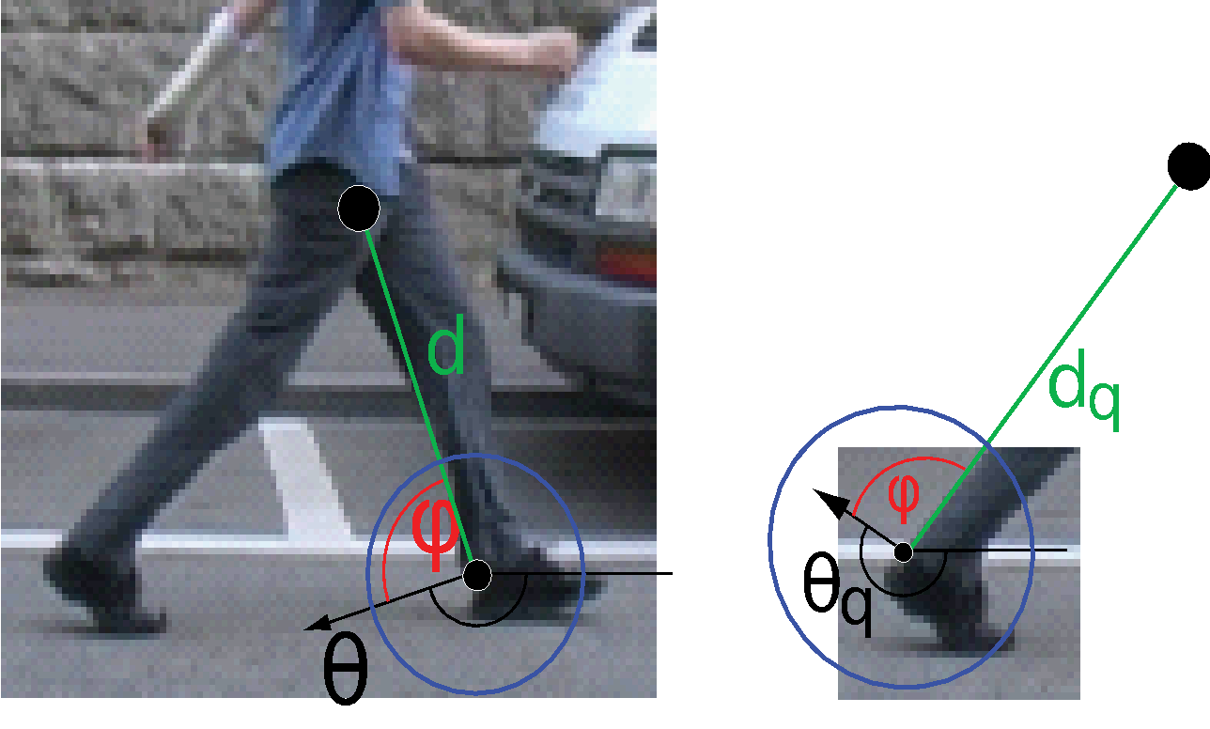
Motivation for using local features
Global representations such as HOG have major limitations and fails to deal with
Intra-category variations
Partial occlusions
Various rotations

Slide 3




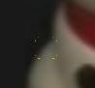
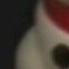
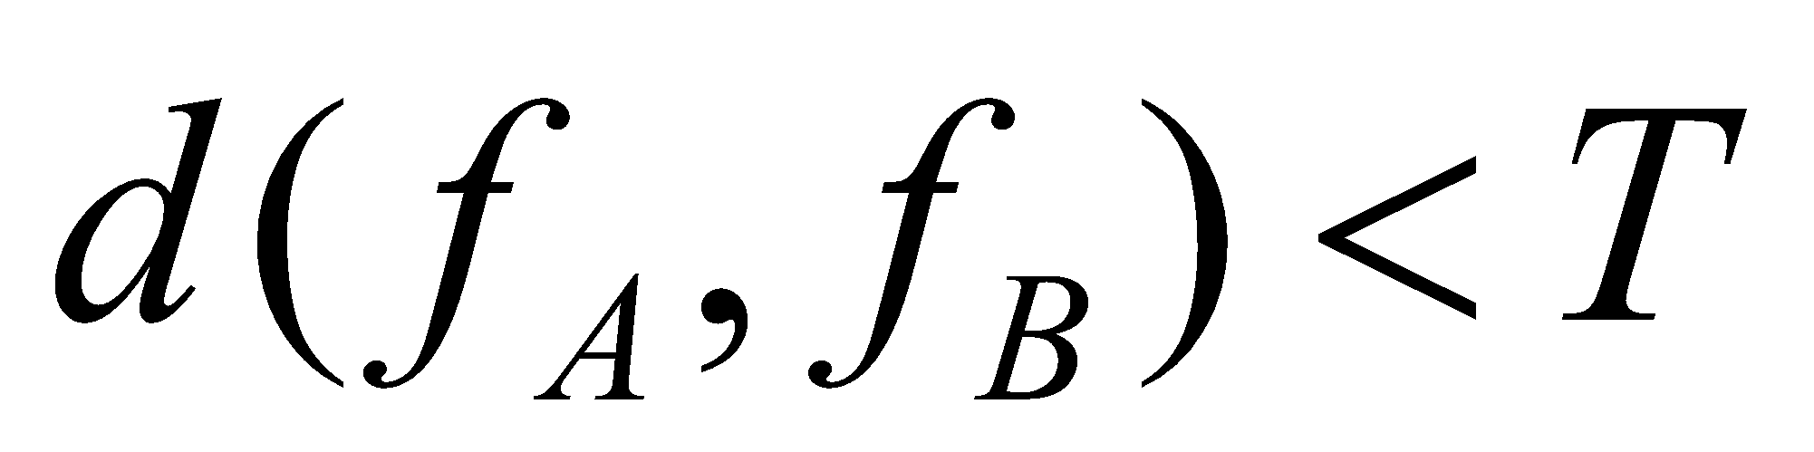
Matching pairs of images locally
1. Find a set of distinctive key- points
A₁
B₃
2. Define a region around each keypoint
A₂
A₃
B₁
B₂
3. Extract and normalize the region content
Similarity measure
4. Compute a local descriptor from the normalized region
N pixels
e.g. color
e.g. color
N pixels
5. Match local descriptors
Slide credit: Bastian Leibe

Slide 4
Requirements
Region extraction needs to be repeatable and accurate
Invariant to translation, rotation, scale changes
Robust or covariant to out-of-plane (≈affine) transformations
Robust to lighting variations, noise, blur, quantization
Locality: Features are local, therefore robust to occlusion and clutter.
Quantity: We need a sufficient number of regions to cover the object.
Distinctiveness: The regions should contain “interesting” structure.
Efficiency: Close to real-time performance.
Slide credit: Bastian Leibe

Slide 5
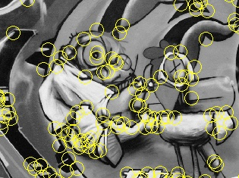
Keypoint Localization
Goals:
Repeatable detection
Precise localization
Interesting content
⇒ Look for two-dimensional signal changes
Slide credit: Bastian Leibe

Slide 6
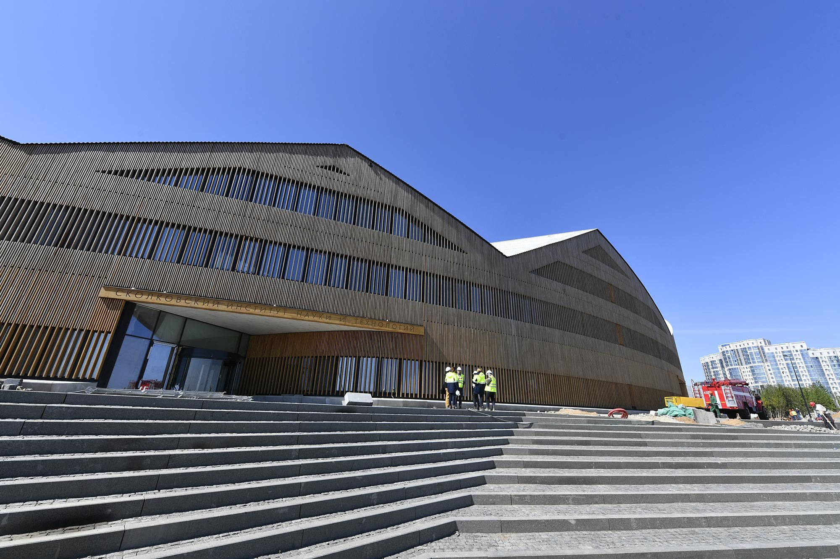
Corners detection
What is the difference between a corner and an edge?

Slide 7
Corners detection
What is the difference between a corner and an edge?

Slide 8
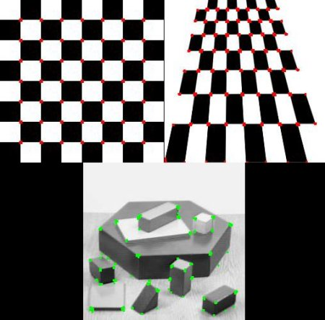
Finding Corners
Key property:
In the region around a corner, image gradient has two or more dominant directions
Corners are repeatable and distinctive
https://docs.opencv.org/3.4/dc/d0d/tutorial_py_features_harris.html

Slide 9

Corners as Distinctive Interest Points
Design criteria
We should easily recognize the point by looking through a small window (locality)
Shifting the window in any direction should give a large change in intensity (good localization)
Slide credit: Alyosha Efros
“flat” region: no change in all directions
“edge”: no change along the edge direction
“corner”: significant change in all directions

Slide 10
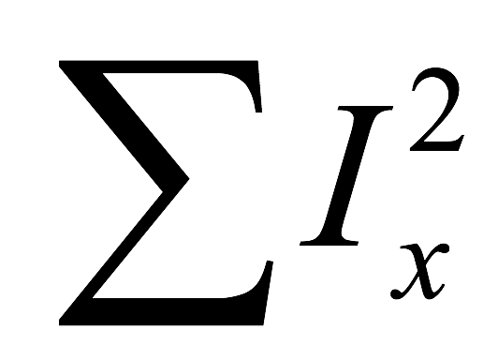
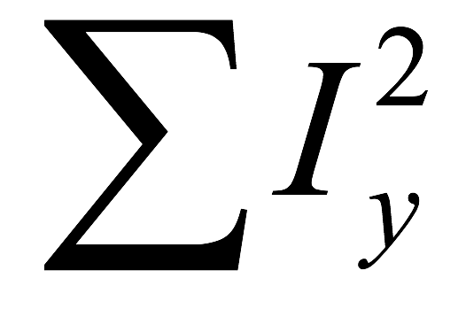
Corners versus edges
Large
Corner
Large
Small
Edge
Large
Small
Nothing
Small

Slide 11
Corners versus edges
??
Corner
??

Slide 12
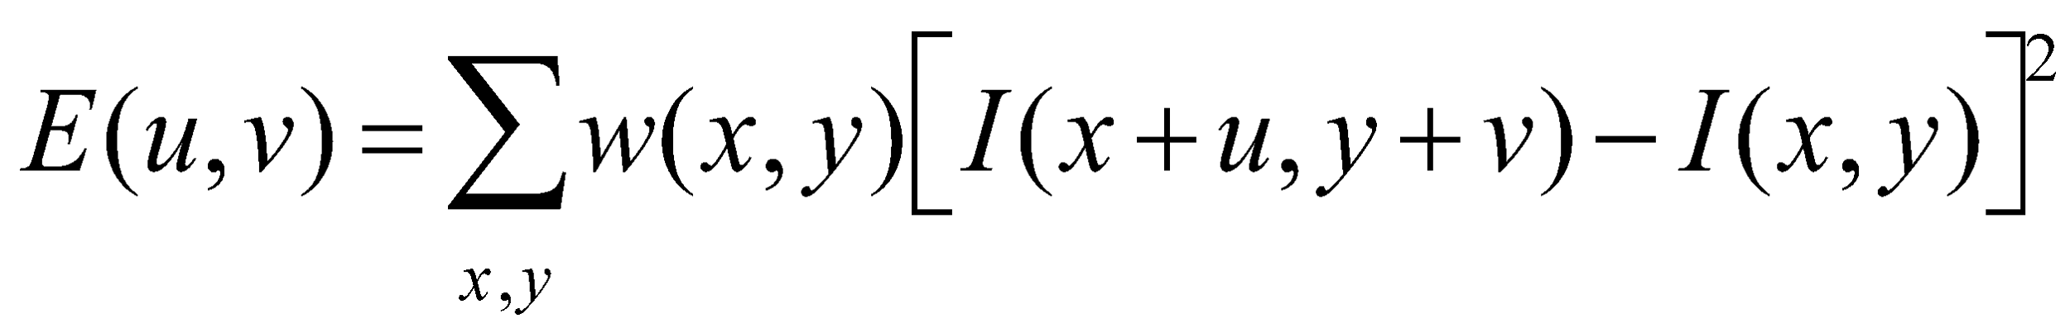
Harris Detector Formulation
Change of intensity for the shift [u,v]:
Window function
Shifted intensity
Intensity
Window function w(x,y) =
or
1 in window, 0 outside
Gaussian
Slide credit: Rick Szeliski

Slide 13
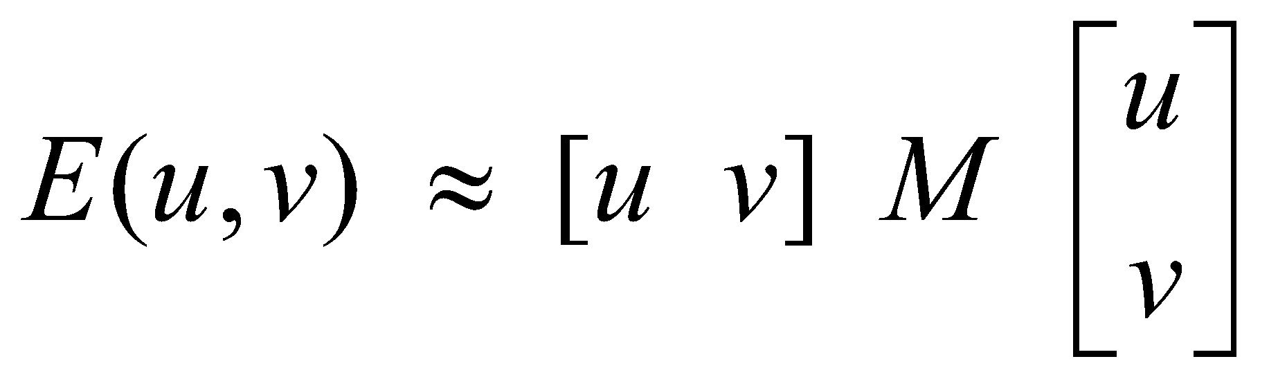
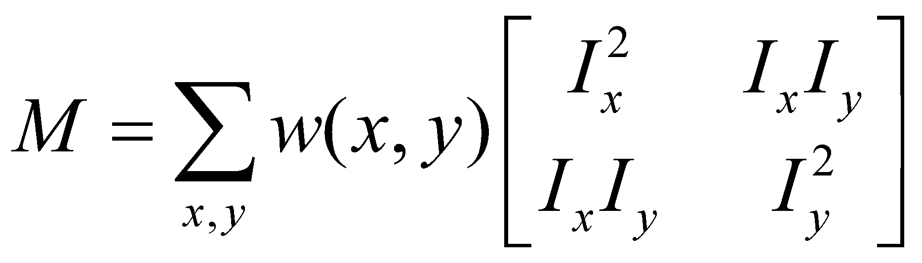
Harris Detector Formulation
This measure of change can be approximated by:
where M is a 2×2 matrix computed from image derivatives:
Gradient with respect to x, times gradient with respect to y
Sum over image region – the area we are checking for corner
M
Slide credit: Rick Szeliski

Slide 14
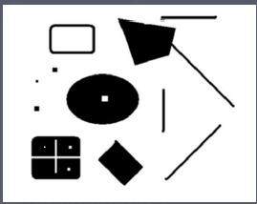
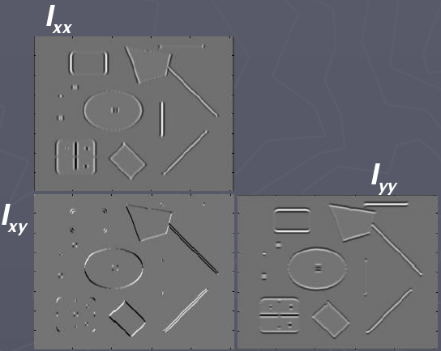
Harris Detector Formulation
Image I
I_{x}
I_{y}
I_{x}I_{y}
Slide credit: Rick Szeliski

Slide 15
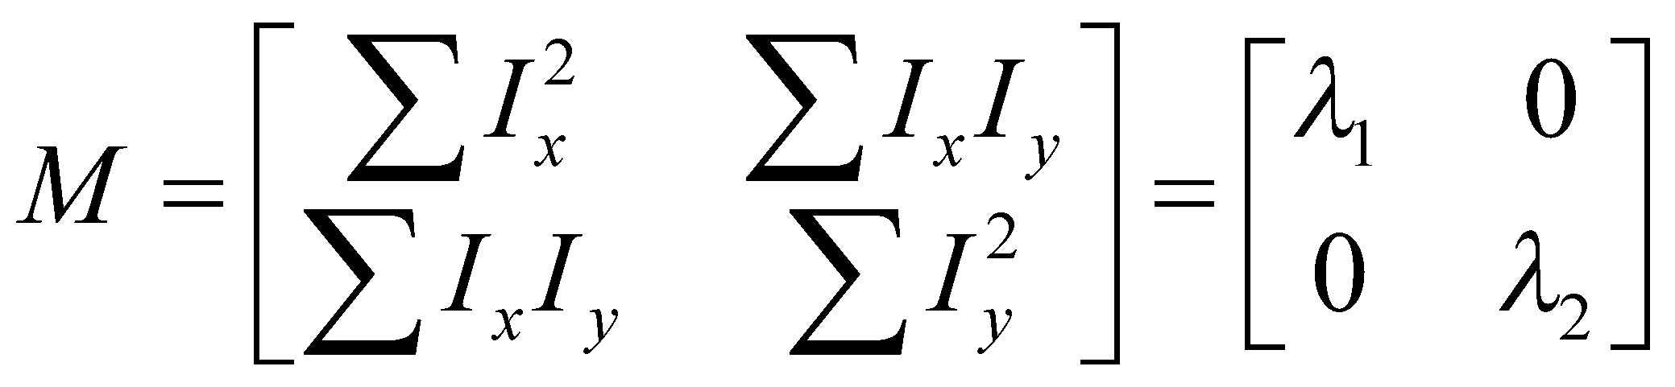
What Does This Matrix Reveal?
First, let’s consider an axis-aligned corner:
This means:
Dominant gradient directions align with x or y axis
If either λ is close to 0, then this is not a corner, so look for locations where both are large.
What if we have a corner that is not aligned with the image axes?
Slide credit: David Jacobs
Notes:
Sum over neighborhood 🡪 some pixels with Ix only, some others with Iy only.

Slide 16
What Does This Matrix Reveal?
First, let’s consider an axis-aligned corner:
This means:
Dominant gradient directions align with x or y axis
If either λ is close to 0, then this is not a corner, so look for locations where both are large.
What if we have a corner that is not aligned with the image axes?
Slide credit: David Jacobs

Slide 17
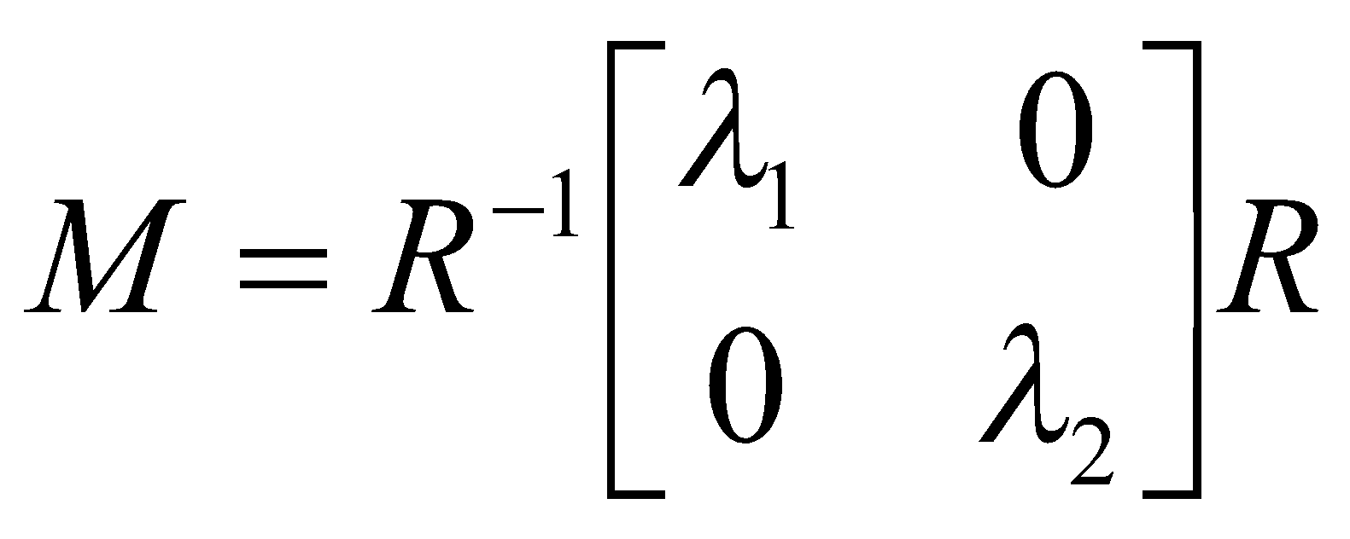
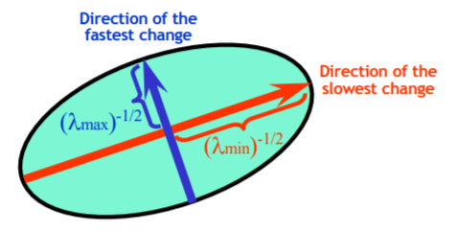
General Case
Since M is symmetric, we have
We can visualize M as an ellipse with axis lengths determined by the eigenvalues and orientation determined by R
(Eigenvalue decomposition)
adapted from Darya Frolova, Denis Simakov

Slide 18
Interpreting the Eigenvalues
Classification of image points using eigenvalues of M:
λ₂
“Edge” λ₂ >> λ₁
“Corner” λ₁ and λ₂ are large, λ₁ ~ λ₂; E increases in all directions
λ₁ and λ₂ are small; E is almost constant in all directions
“Flat” region
“Edge” λ₁ >> λ₂
λ₁
Slide credit: Kristen Grauman

Slide 19
Corner Response Function
Fast approximation
Avoid computing the eigenvalues
α: constant (0.04 to 0.06)
λ₂
“Edge” θ < 0
“Corner” θ > 0
“Flat” region
“Edge” θ < 0
λ₁
Slide credit: Kristen Grauman

Slide 20
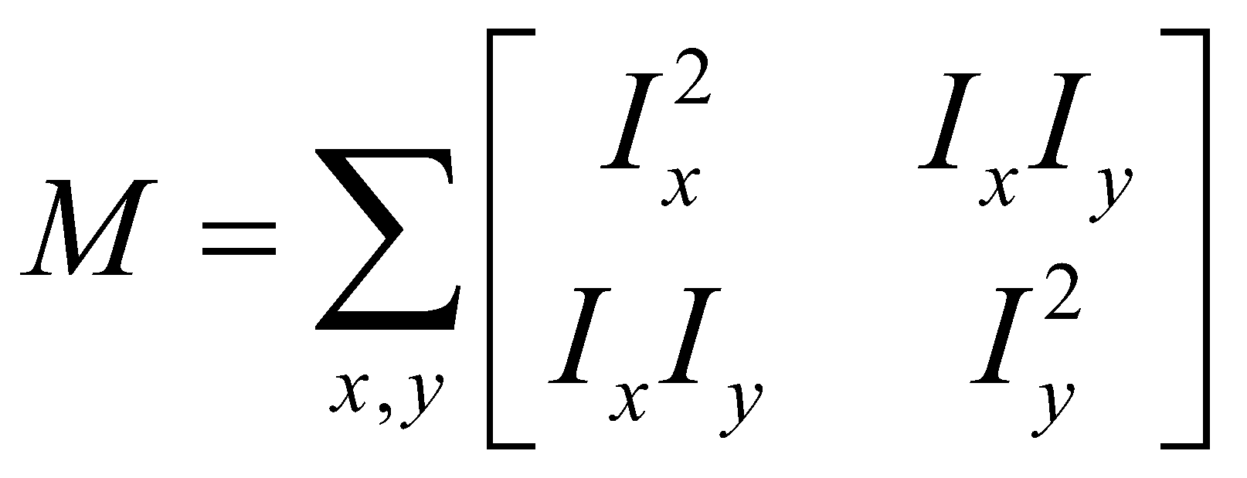
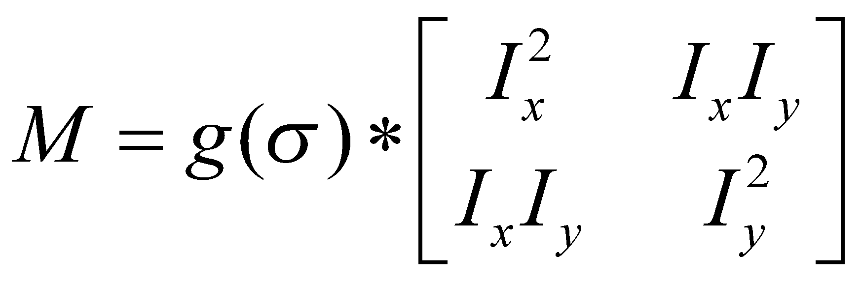
Window Function w(x,y)
Option 1: uniform window
Sum over square window
Problem: not rotation invariant
Option 2: Smooth with Gaussian
Gaussian already performs weighted sum
Result is rotation invariant
1 in window, 0 outside
Gaussian
Slide credit: Bastian Leibe

Slide 21
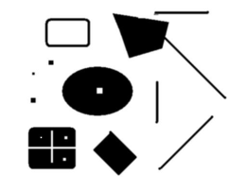
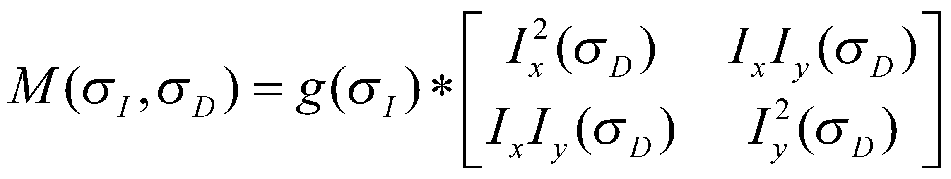
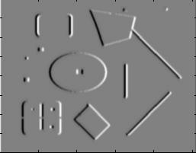
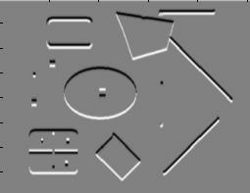
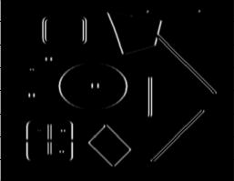
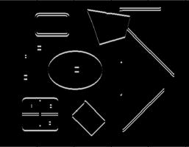
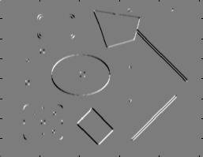
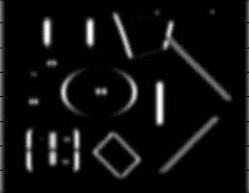
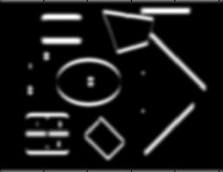
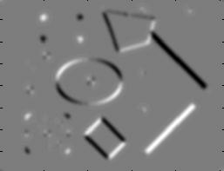
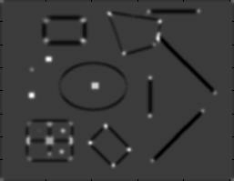
Summary: Harris Detector [Harris88]
Compute second moment matrix
1. Image derivatives
I_{x}
I_{y}
I_{x}²
I_{y}²
I_{x}I_{y}
2. Square of derivatives
3. Gaussian filter g(σ_{I})
4. Cornerness function – two strong eigenvalues
g(I_{x}²)
g(I_{y}²)
g(I_{x}I_{y})
5. Perform non-maximum suppression
R
Slide credit: Krystian Mikolajczyk

Slide 22
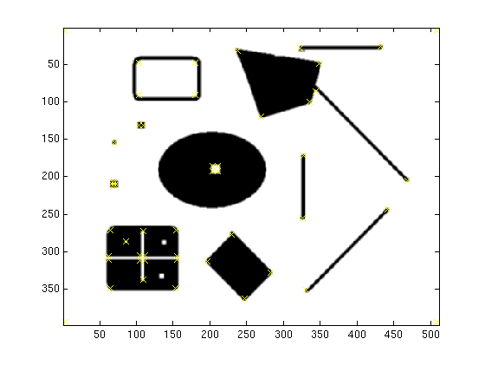
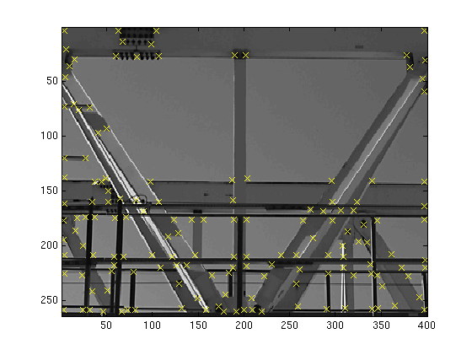
Harris Detector – Responses [Harris88]
Effect: A very precise corner detector.
Slide credit: Krystian Mikolajczyk

Slide 23
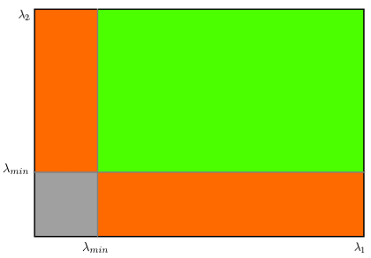
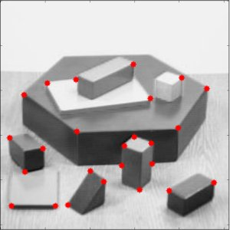
Shi-Tomasi corner detection
Harris corner response:
Shi-Tomasi corner response
More appropriate for tracking

Slide 24
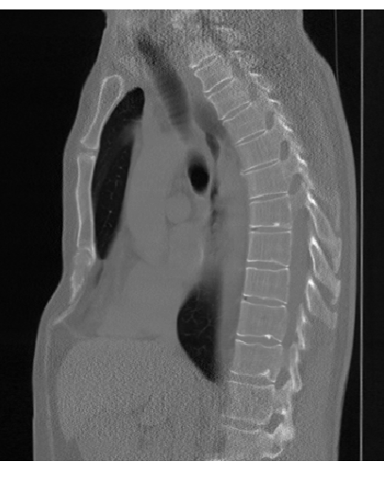
Harris Detector: Exercise
Implement the pipeline
Step 1. Use np.gradient to calculate image gradients and skimage.filters.gaussian.
Calculate theta
Use skimage.measure.label

Slide 25
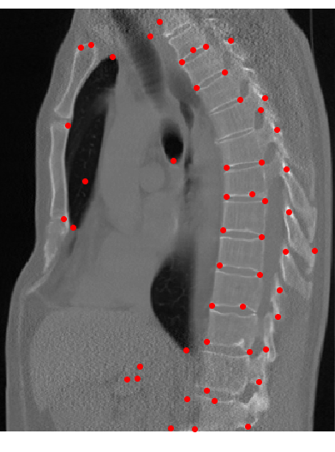
Harris Detector: Exercise
Implement the pipeline
Step 1. Use np.gradient to calculate image gradients and skimage.filters.gaussian.
Calculate theta
Use skimage.measure.label
Test the pipeline using
Shift
Scaling
Rotating

Slide 26
Harris Detector: Properties
Translation invariance?
Slide credit: Kristen Grauman

Slide 27
Harris Detector: Properties
Translation invariance
Rotation invariance?
Ellipse rotates but its shape (i.e. eigenvalues) remains the same
Corner response θ is invariant to image rotation
Slide credit: Kristen Grauman

Slide 28
Harris Detector: Properties
Translation invariance
Rotation invariance
Scale invariance?
Corner
All points will be classified as edges!
Not invariant to image scale!
Slide credit: Kristen Grauman

Slide 29
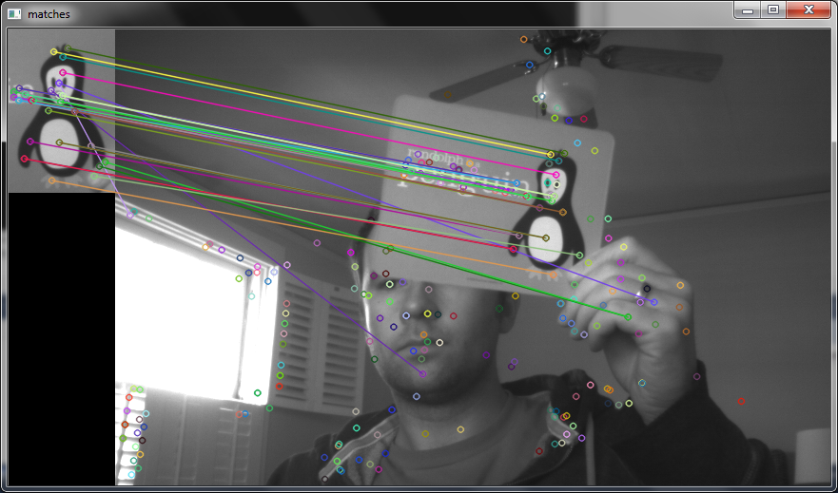
Detecting Blobs
Blobs are distinctive regions, usually of different brightness.
They are useful to calculate features over them, to match this regions over different images
Sift blobs example - keypoints are usually not at the corners, but more likely at the center of blobs (look at the penguin)
Source https://chrisjmccormick.files.wordpress.com/2013/01/siftmatching.png

Slide 30
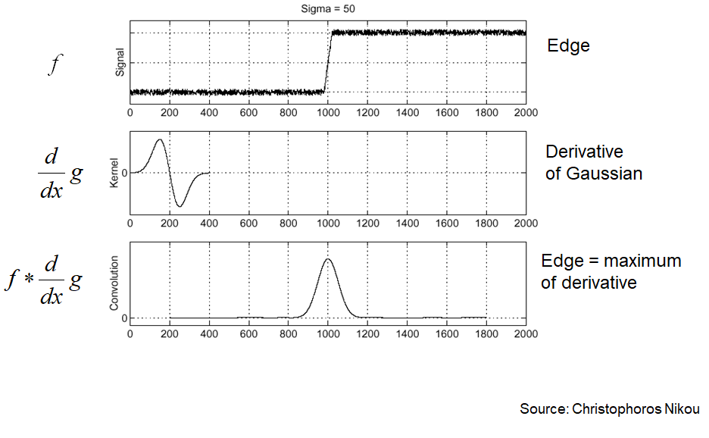
Detecting edges

Slide 31
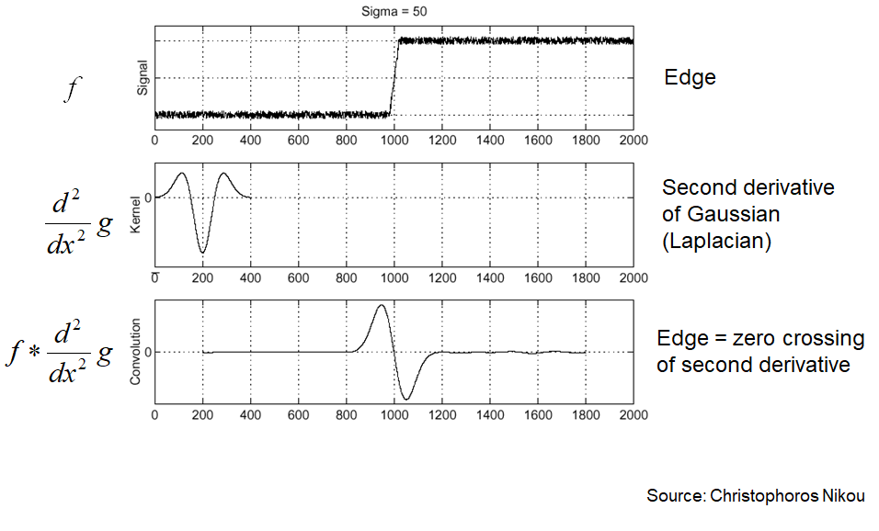
Detecting edges

Slide 32
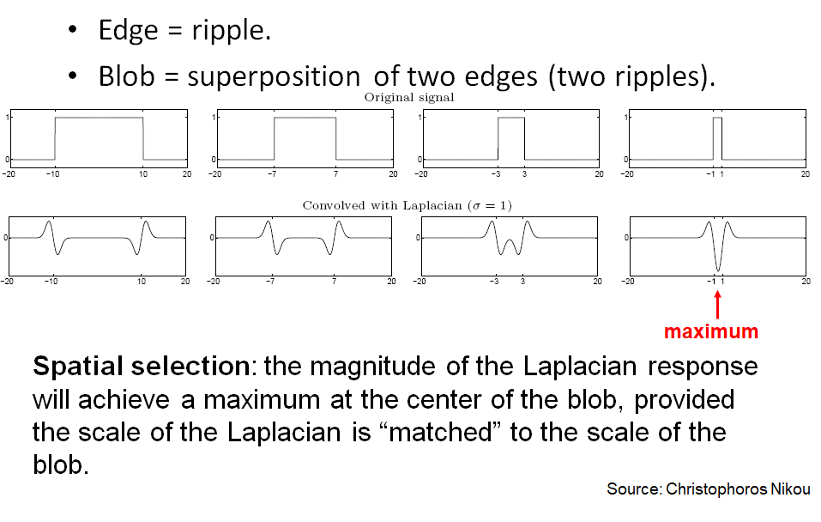
Detecting blobs

Slide 33
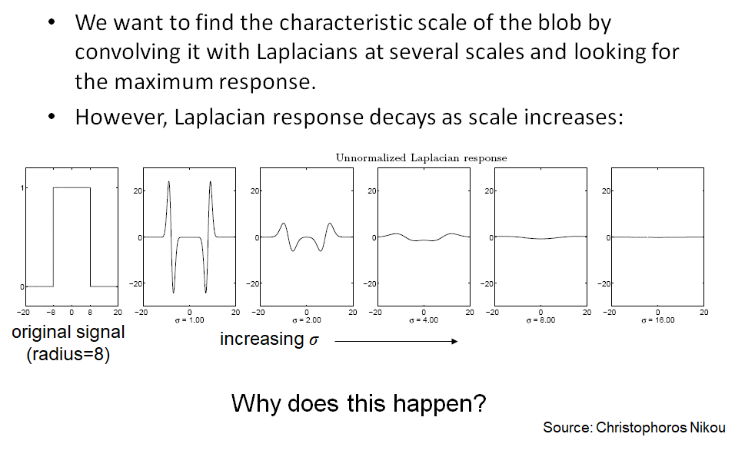
Scale selection

Slide 34
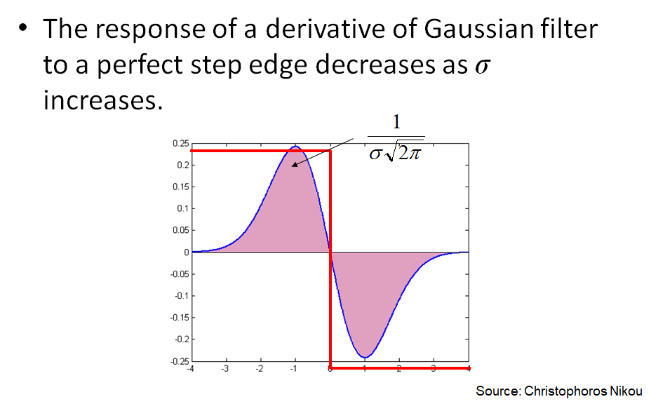
Scale normalization

Slide 35
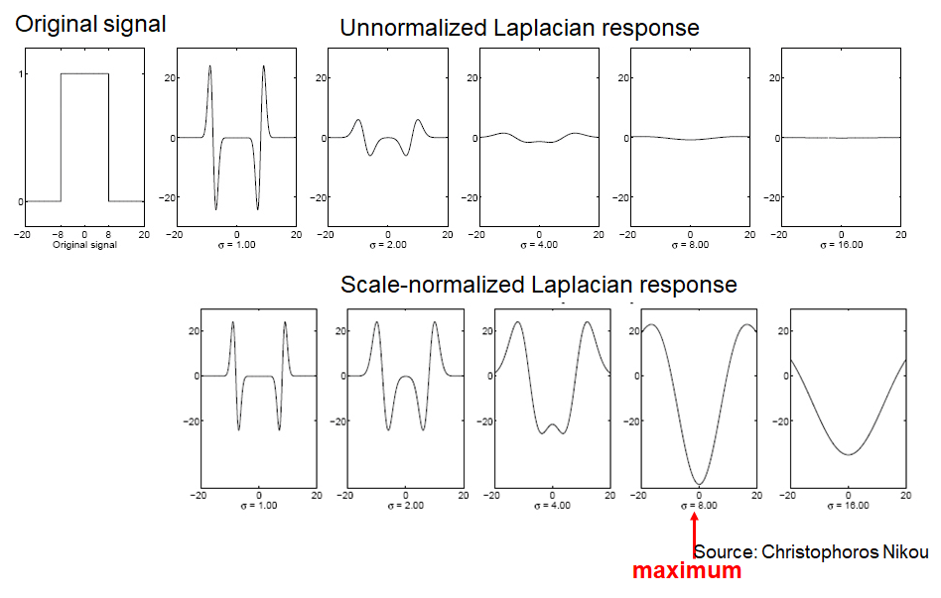
Scale selection

Slide 36
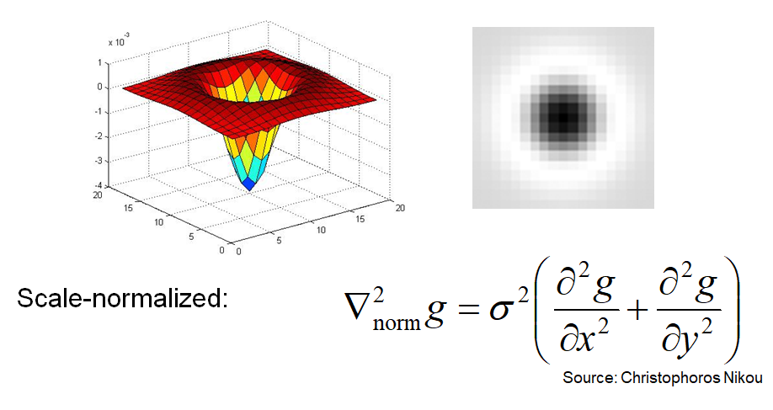
2D blob detection
In 2d we will be looking for blobs that match laplacian shape

Slide 37
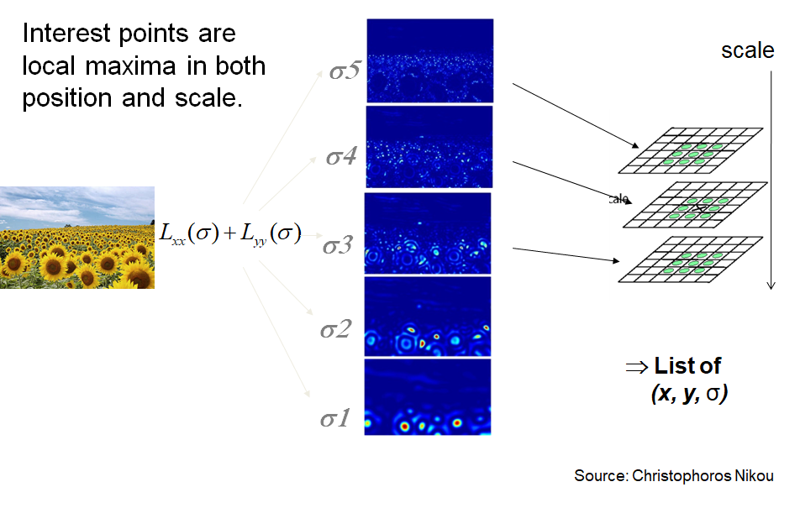
Scale invariant interest points

Slide 38
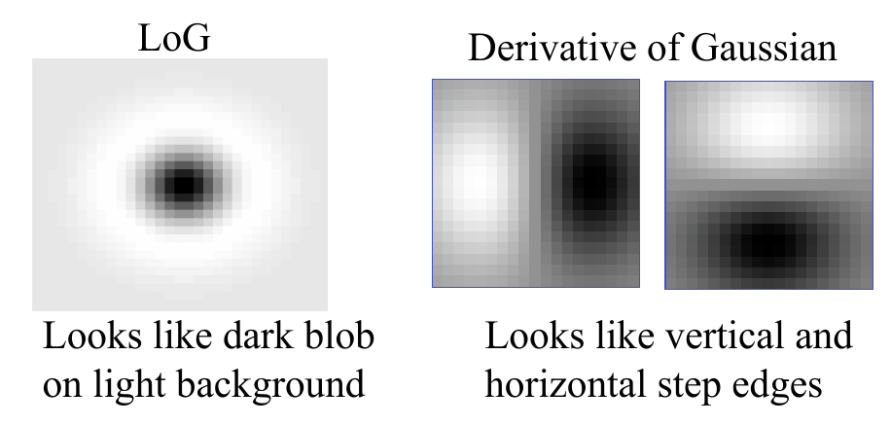
How does LoG work?
In fact, it’s template matching with these templates!
Source: Robert Collins slides about LoG

Slide 39
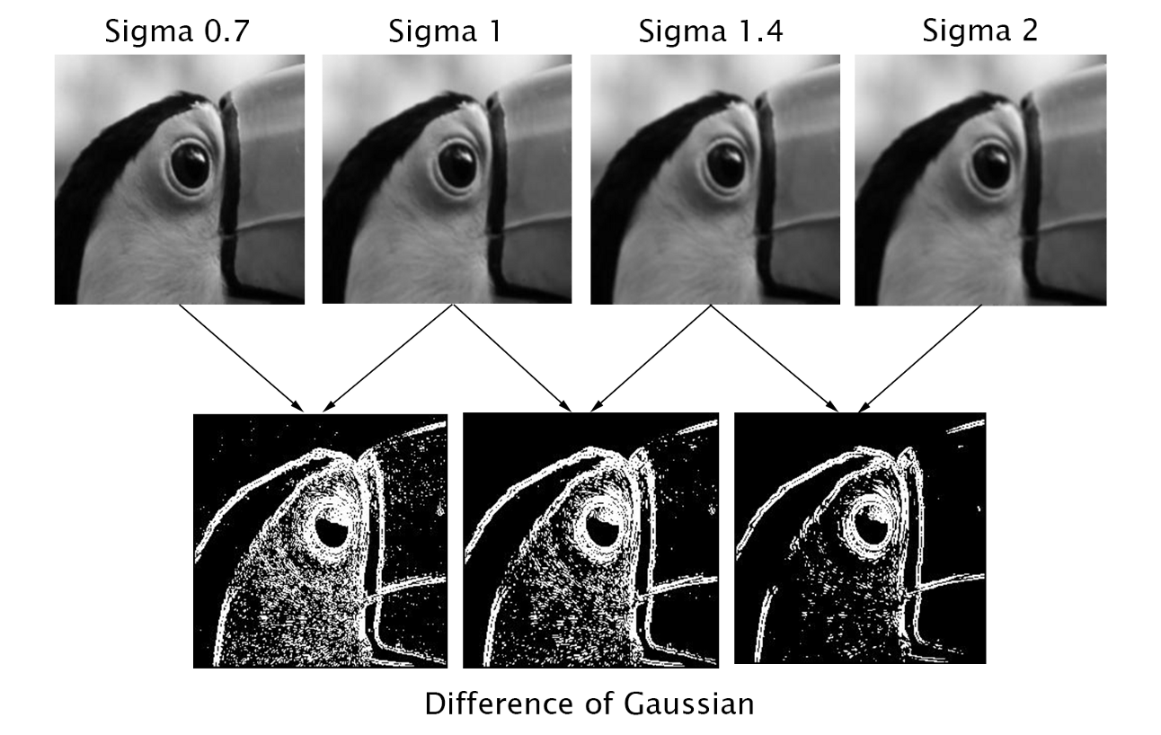
The next lecture preview
How can we implement blob detection?

